Slide 1
R A I L S A P P L I C A T I O N
( M A R K E T P L A C E A P P )
T L O N G
2 0 2 1

Slide 2
SURF SWAP free surfboard swapping app
THE IDEA
Free application for users to list surfboards they want to swap, either individually listed or as a group.
Other users can then make an offer using their own gear which is accepted or rejected.
Meetups at designated Surf Life Saver Clubs.
Minimal personal information by design.
S

Slide 3
SURF SWAP free surfboard swapping app
Expandable to other surf related gear
+ Wetsuits
+ Kites
+ Paddles
Optional paid memberships
S
EXPANDABLE

Slide 4
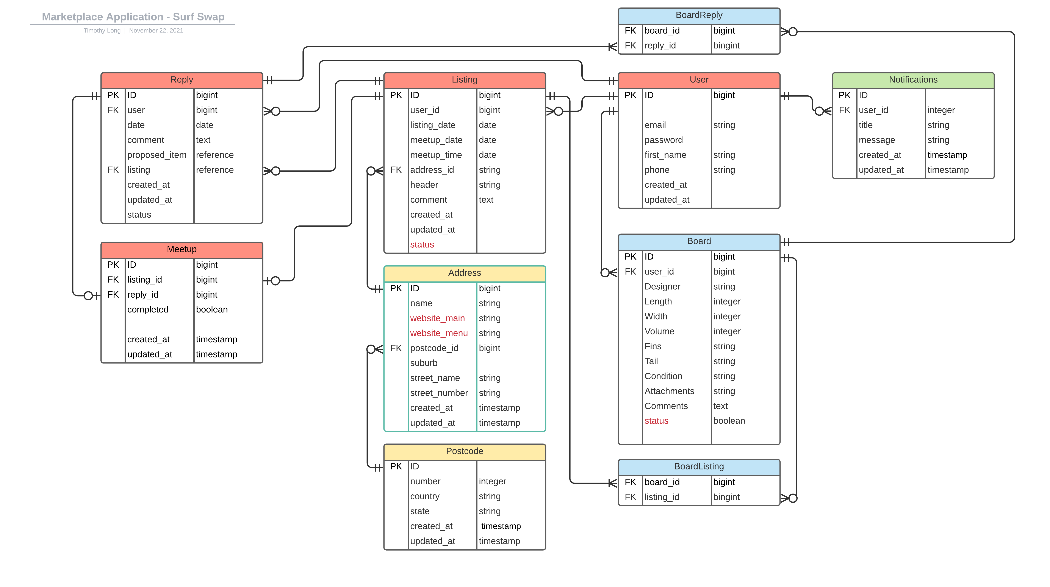

Slide 5
THE
WEBSITE

Slide 6
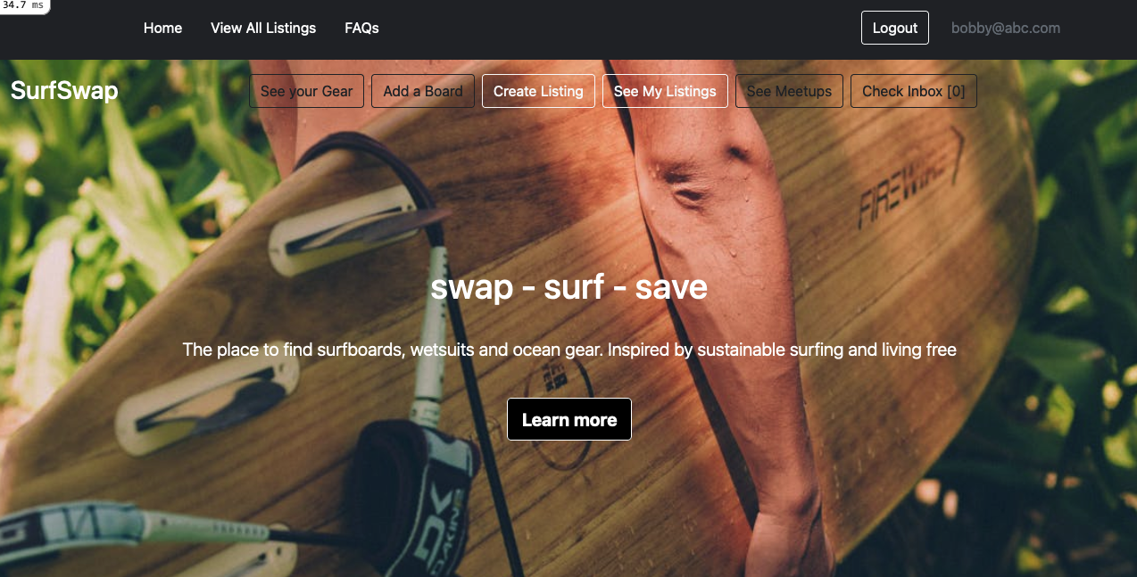
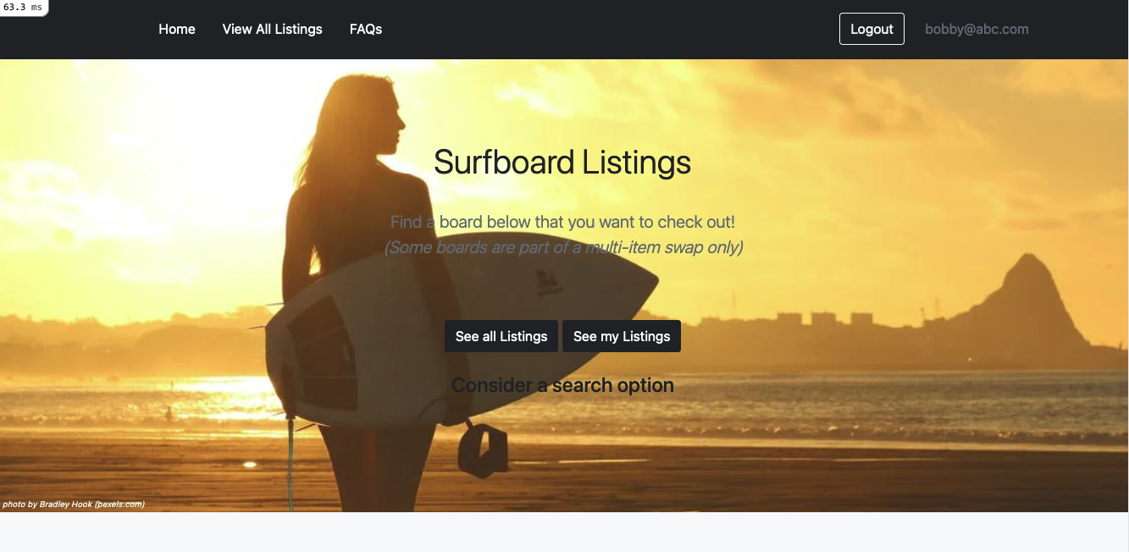

Slide 7
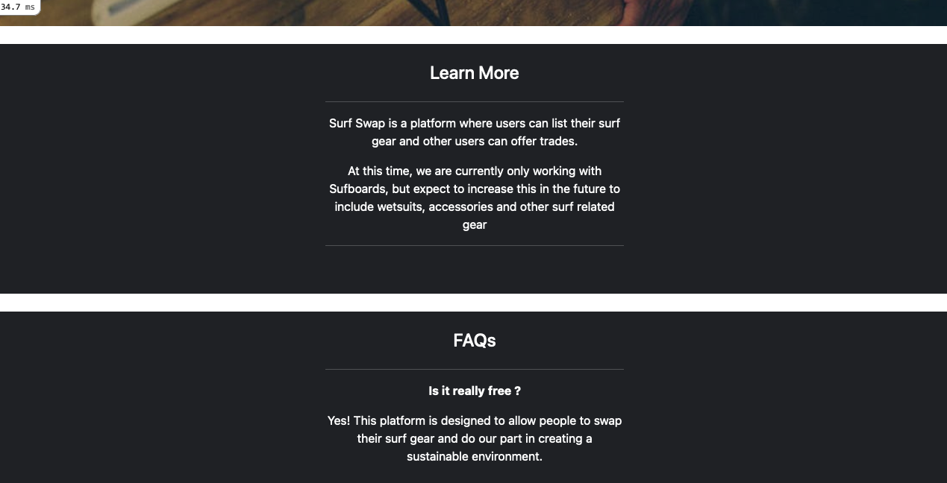

Slide 8
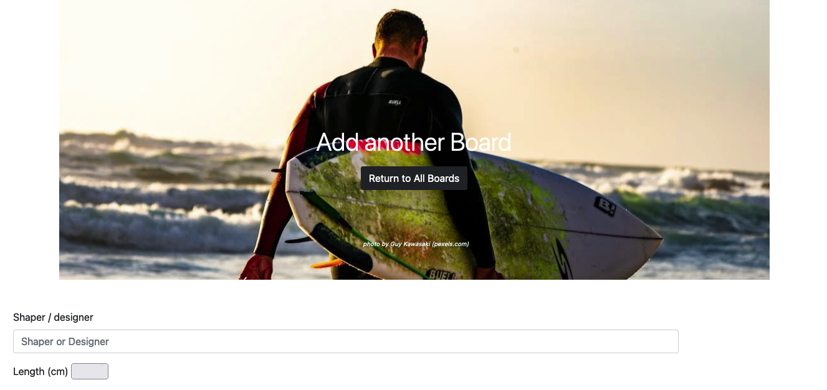

Slide 9
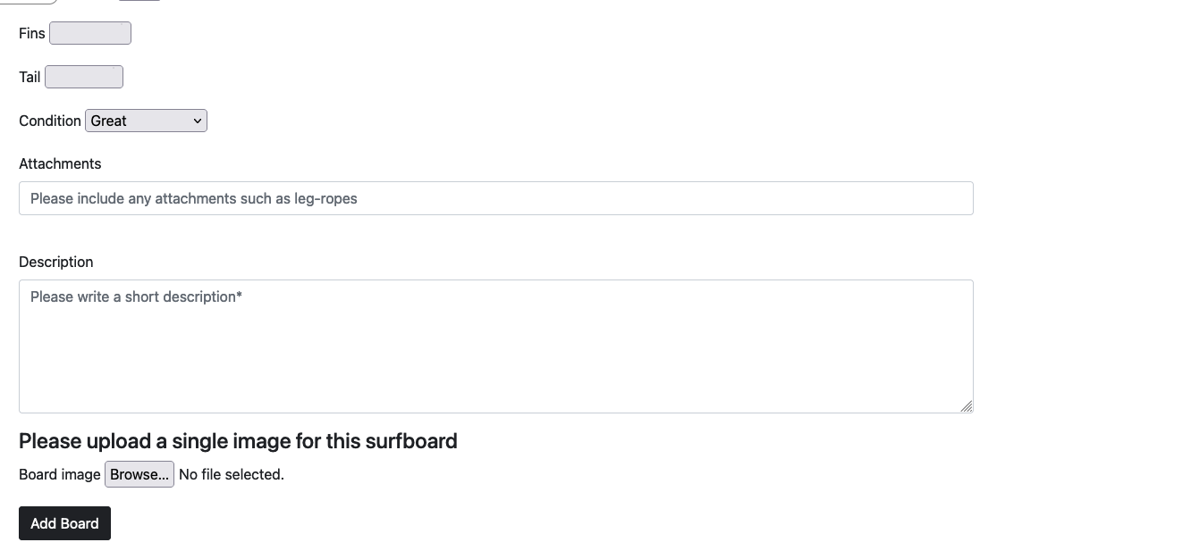

Slide 10
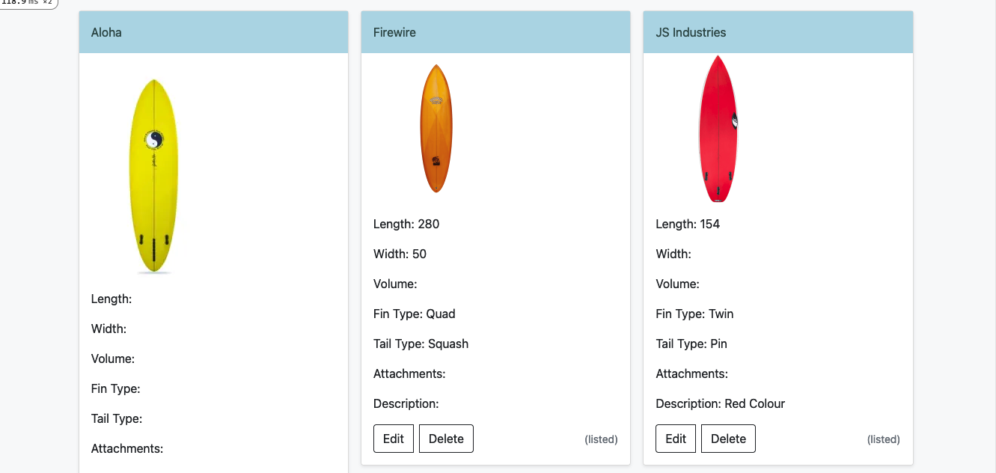

Slide 12
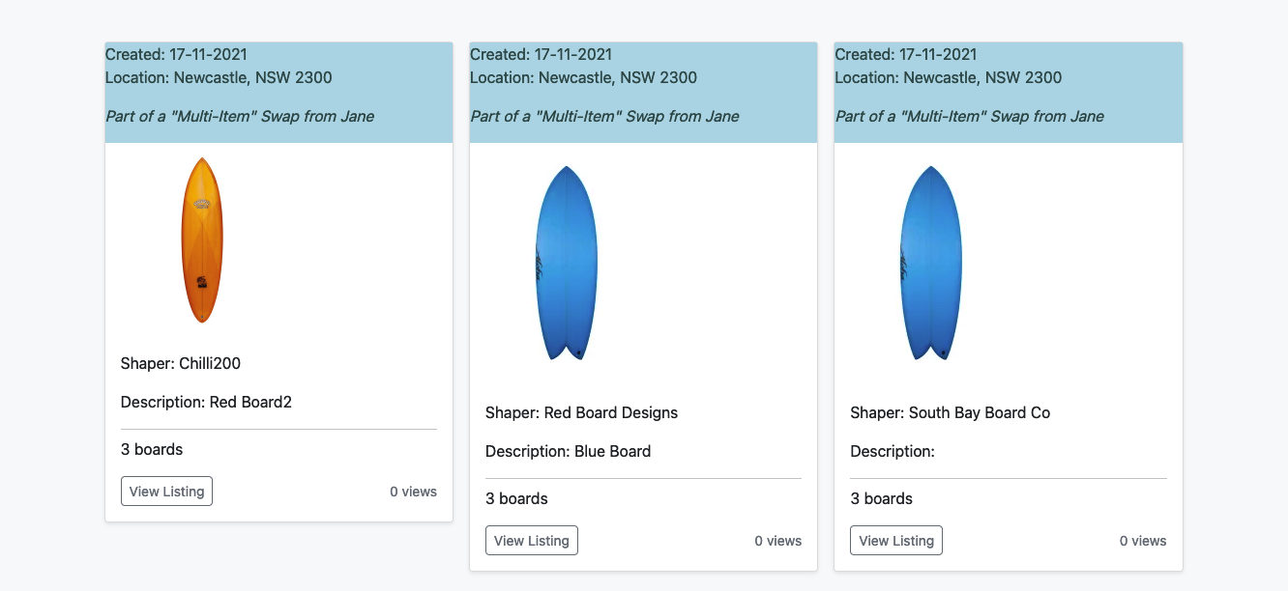

Slide 13
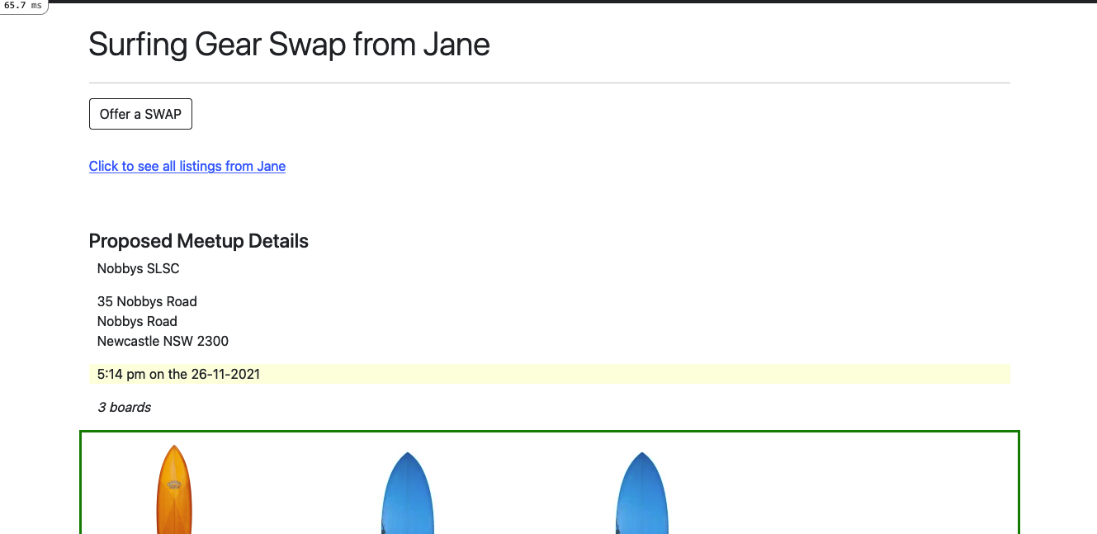

Slide 14
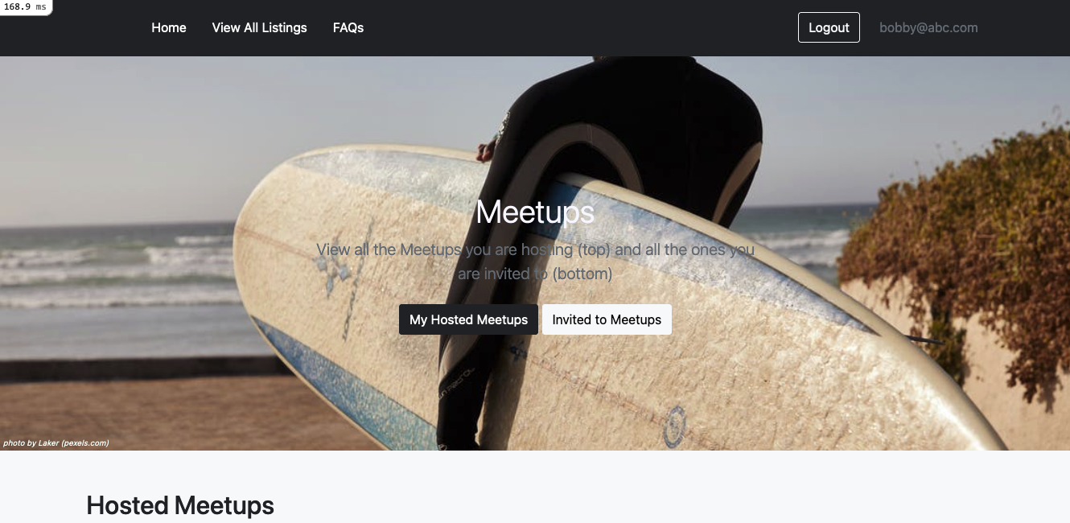

Slide 15
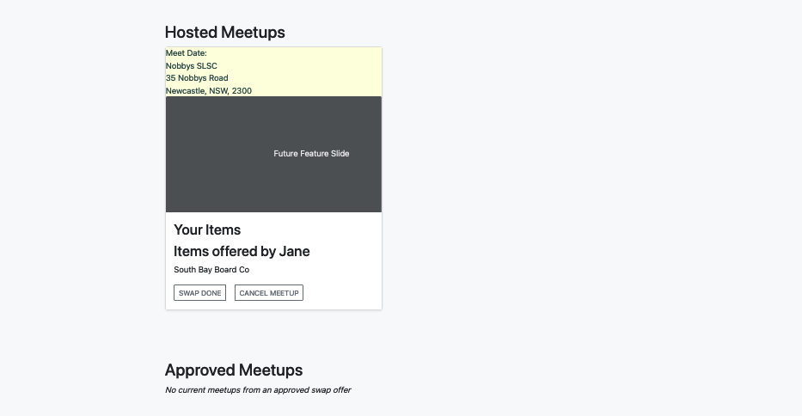

Slide 16
RESPONSIVE
DESIGN

Slide 17
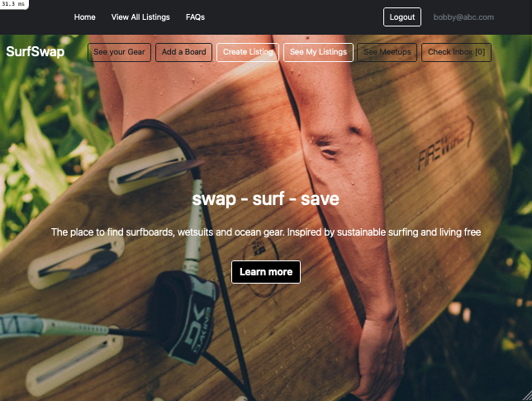
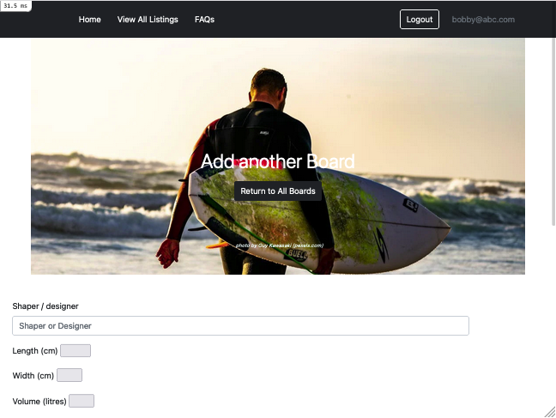
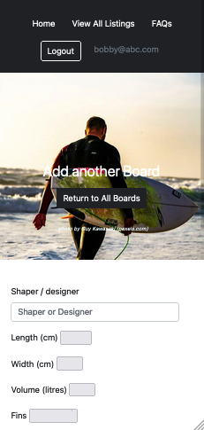
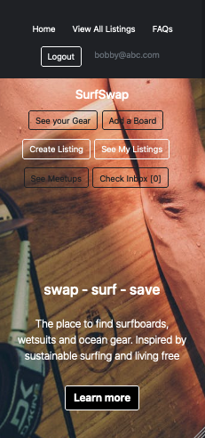

Slide 19
THANK YOU

